Slide 1

Introduction to FSAE driving
TEMPLE FORMULA RACING – DRIVER CLINIC 1
Jakob Werle

Slide 2
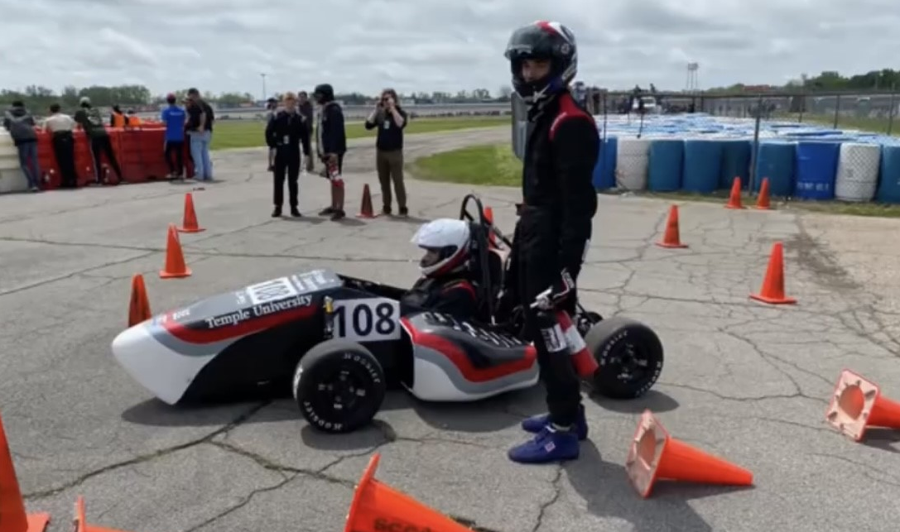
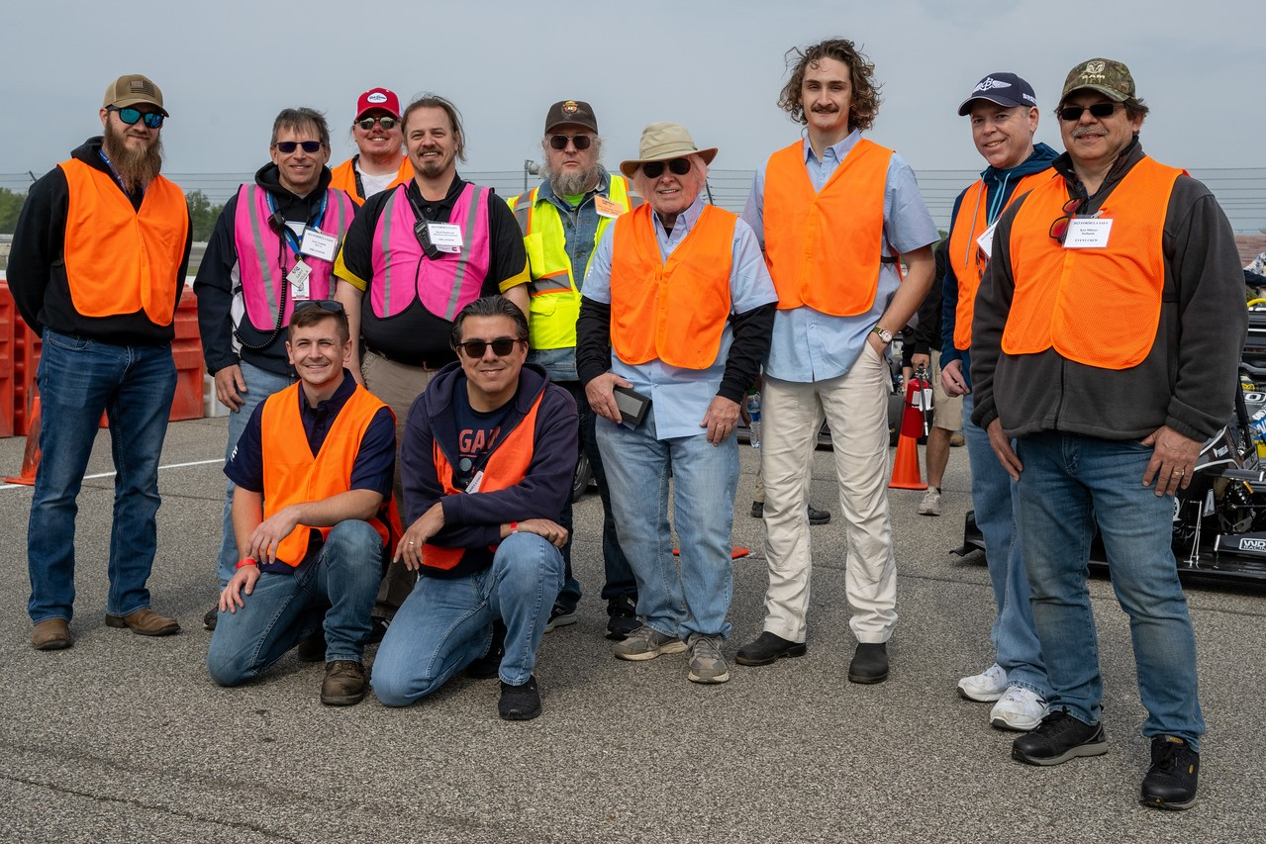
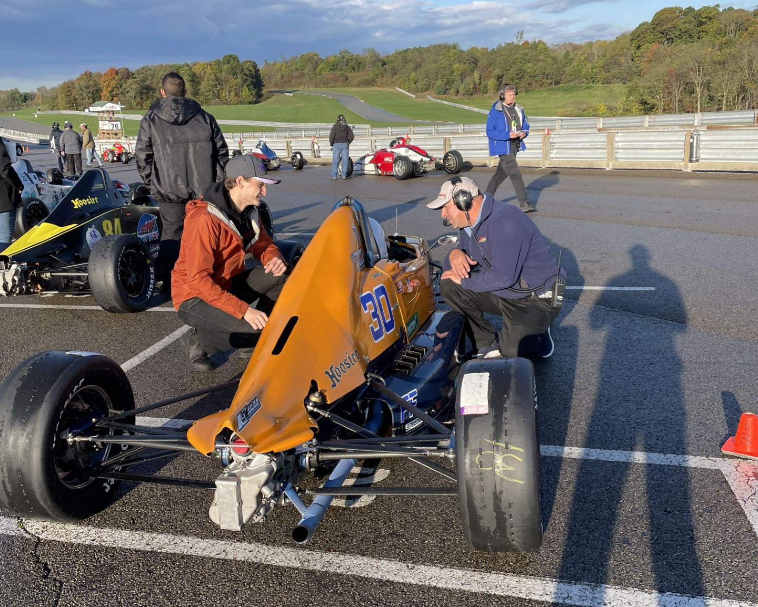
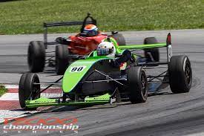
Jakob – who am i?
Joined TFR in 2018
Prior suspension lead and president
Test driver
Pitt Shootout 17th overall
14th place endurance co-driver
FSAE
Technical Scrutineer (FSAE & SCCA)
Testing pad advisor
SCCA/PCA autocross
1000+ hrs sim experience
Currently junior race engineer for ADSA Wright Racing & ANZE

Slide 3
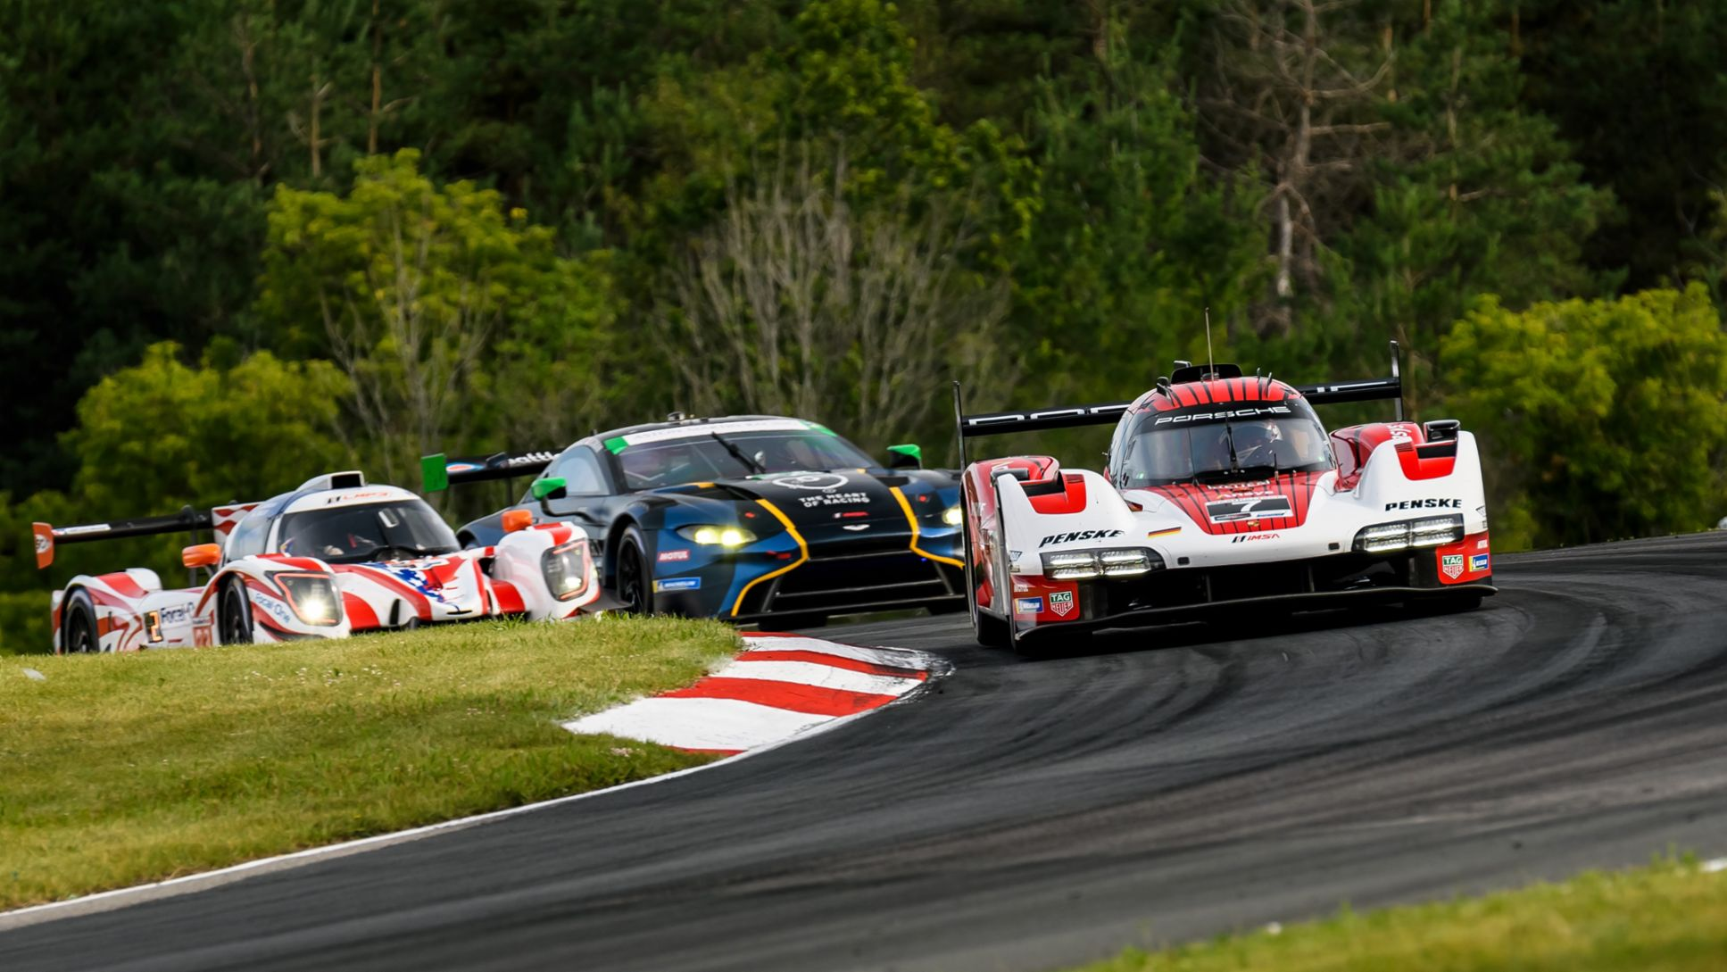
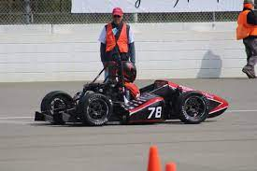
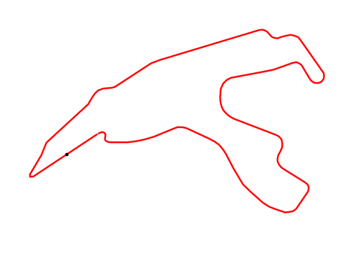
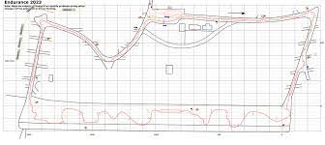
FSAE competition

Slide 4
Driving Fundamentals
Vehicle Operation
Racing skills
Safety / equipment / environment
Controls familiarity
Starting / stopping
Shifting
Steering
Communication
Vision
Line choice
Efficient piloting
Driver feedback
Mindset

Slide 5
Vehicle operations
The part that isn’t racing… yet

Slide 6
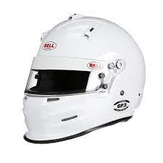
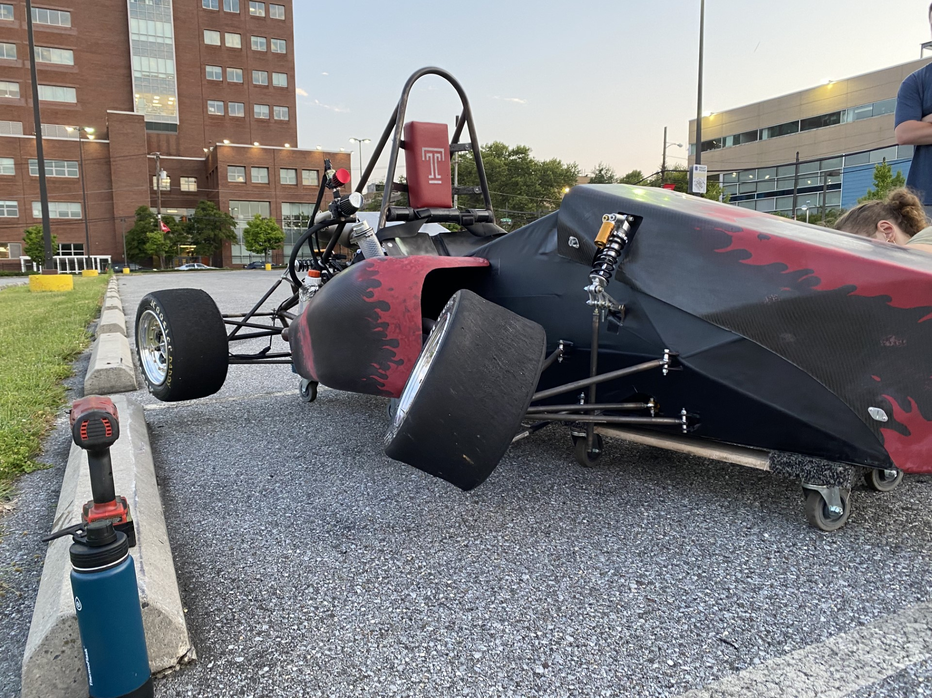
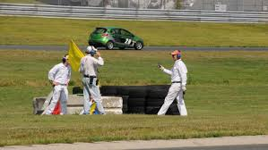
Safety
Driver’s responsibility once car is live
Equipment
Brakes!!!
Harness
Helmet
Fire gear / fire bottles
Environment
Awareness
Track workers
Track layout / obstacles
Weather

Slide 7
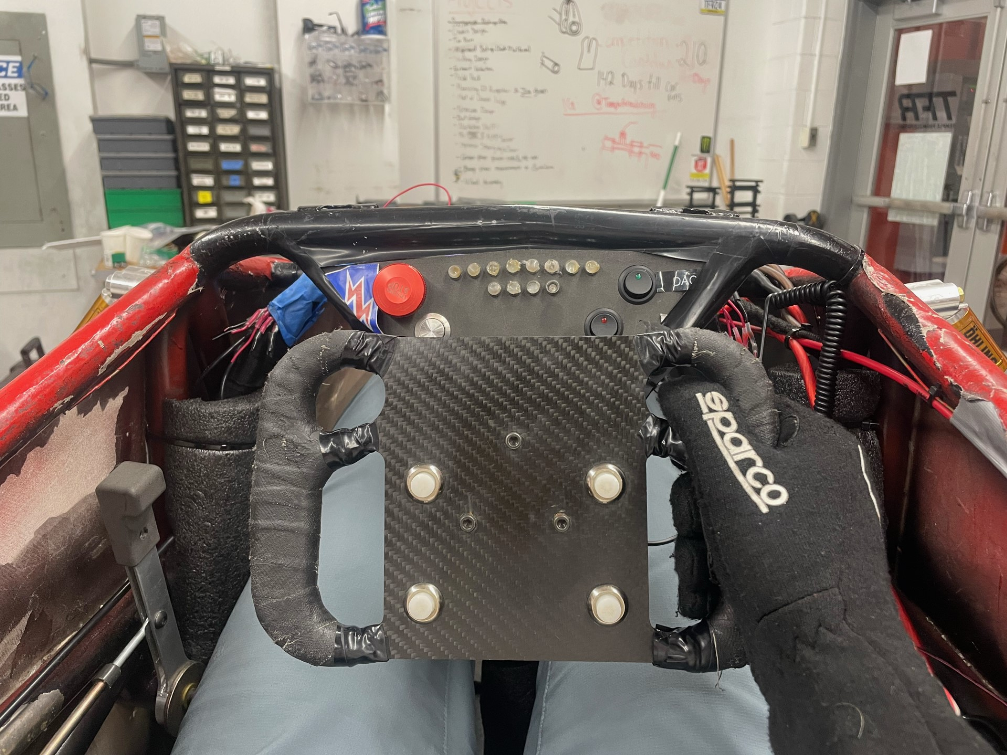
Cockpit controls
E-stop
Tachometer / dash
Ignition
Accessory
switches
Shifter
Steering wheel

Slide 8
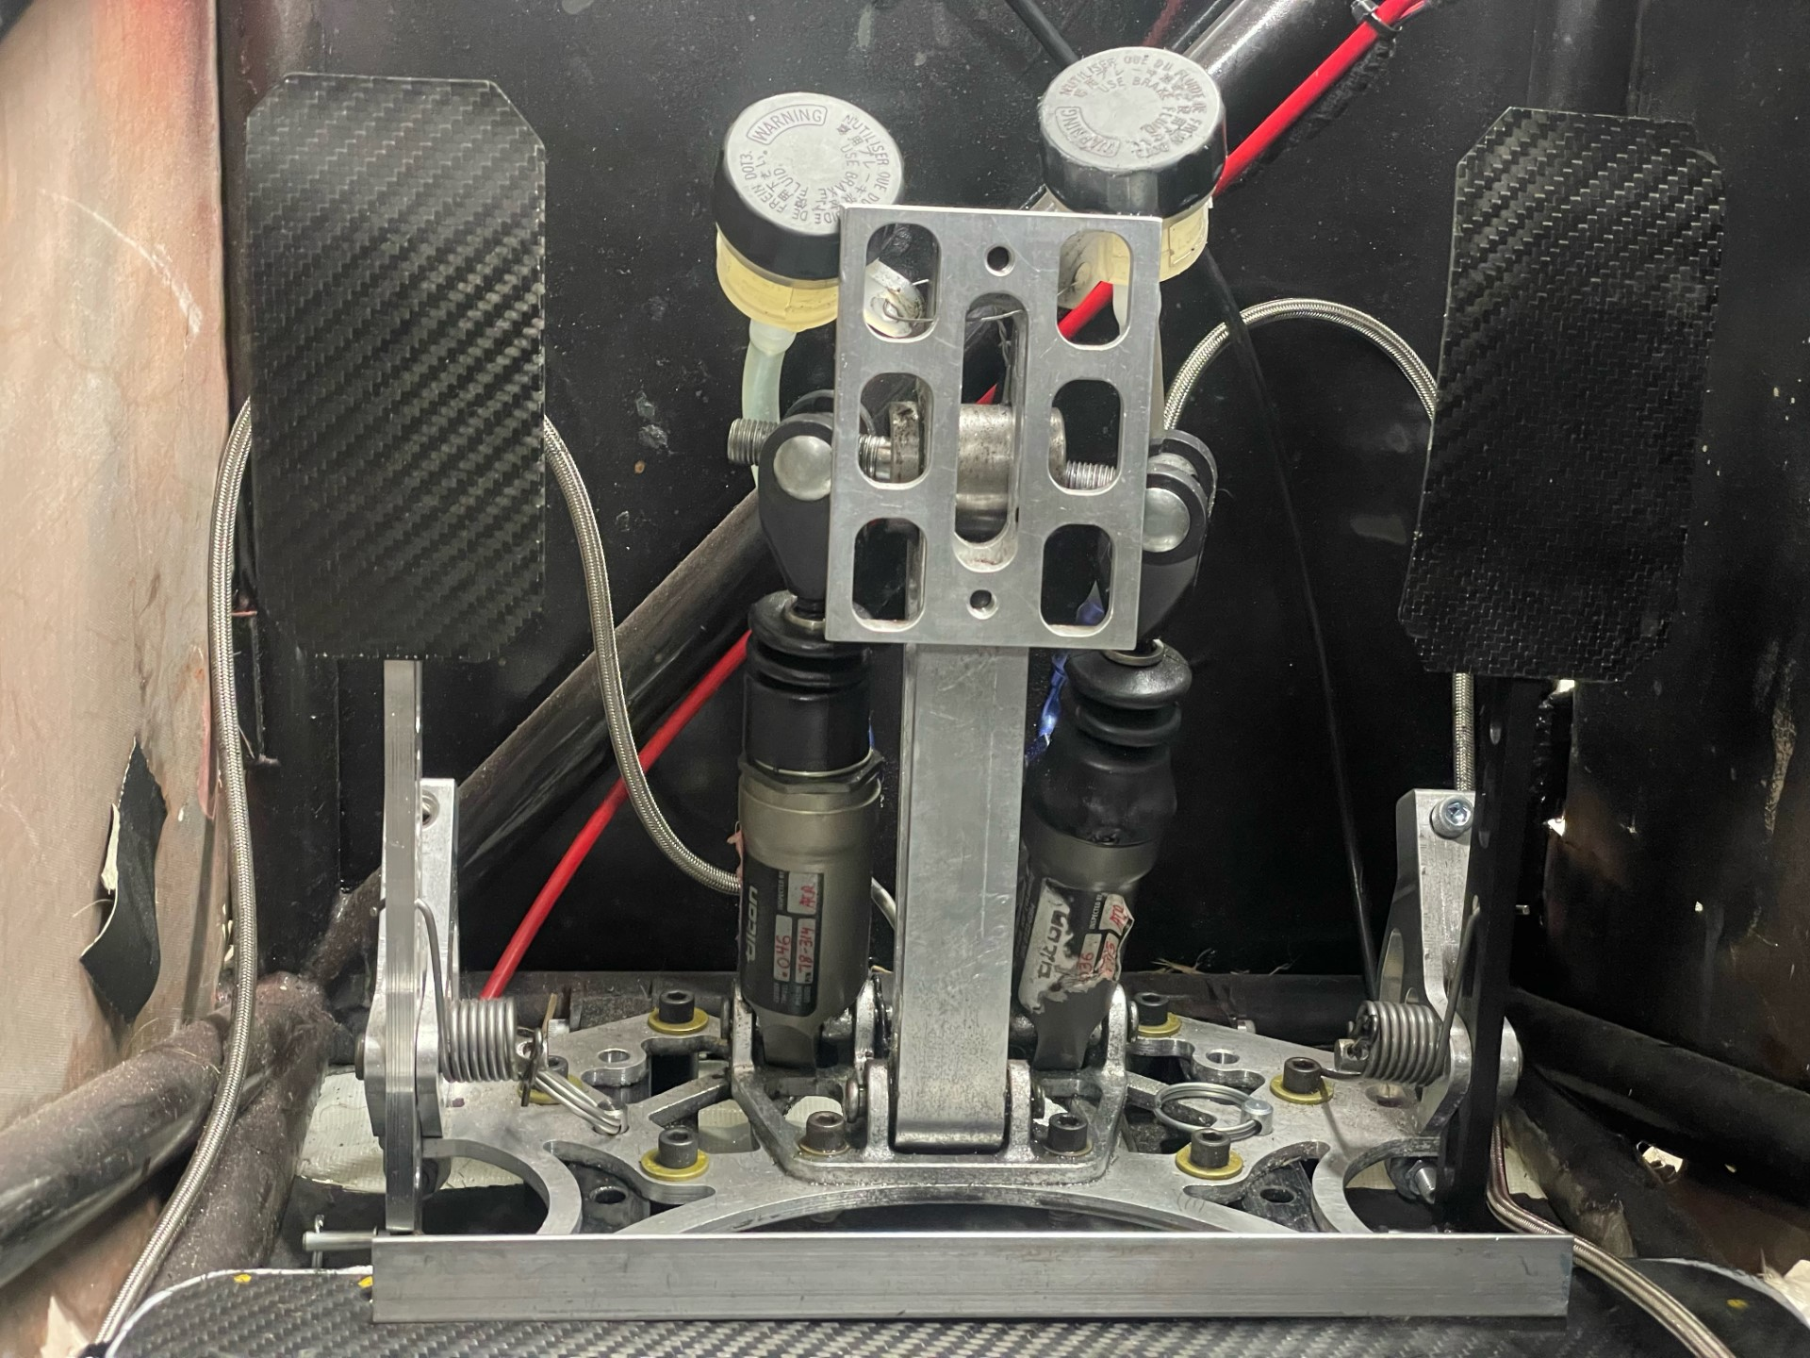
footbox controls
Brake
Clutch
Throttle

Slide 9
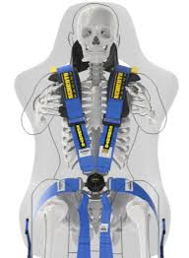
Harness
All belts should be TIGHT and flat
A well secured driver is a safe and fast driver
Twist the quick connect to unbuckle
(Tension will pop belts out of way for egress)
Hip belts
Position over hips, NOT thighs or waist
Tighten across body
Anti-submarine belts
Set length so QC sits just ~ 2in below belly button
Shoulder belts
Deep breath out
Shoulder belt
Quick connect
Hip belt
Anti-sub belt

Slide 10
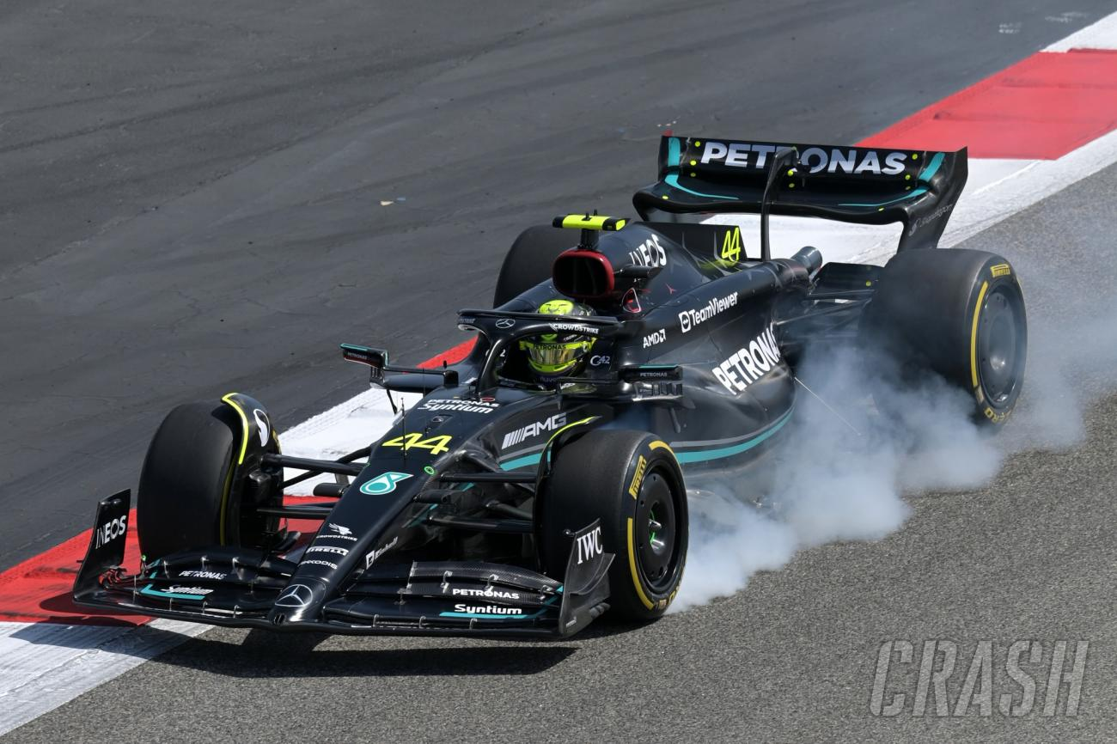
Braking
Race car brakes
No ABS – easy to lock up
High pressure
Very sensitive
Use brakes to slow down!
First line of safety for driver, crew, and track workers
In event of crisis, resort to brakes
Brake Overtravel Switch
Kills engine when hit
If brakes fails, pedal will move excessively

Slide 11
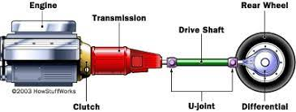
Clutch
Clutch allows engine to gently provide power to wheels
Modulate in friction zone
Engine stalled → let out clutch too abruptly
Fully release clutch once sufficiently moving
Just enough throttle
Release brake when ready to move
When should you clutch?
Start moving
Stopping
Learning to shift
less
more
Engine RPM
Wheel RPM
=
Moving Speed

Slide 12
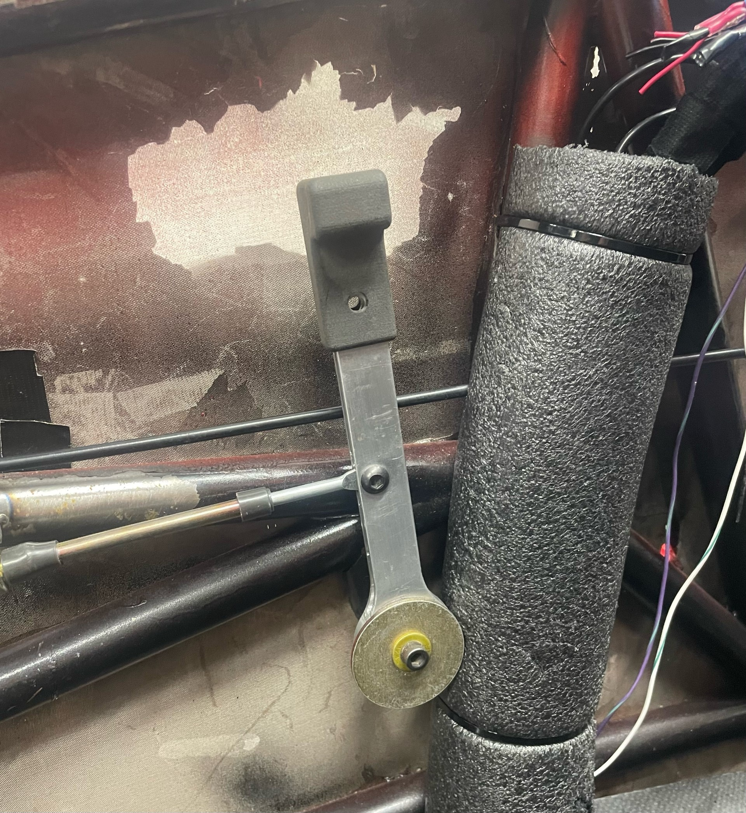
Shifting
Let off throttle
Push in clutch
Shift gear
Down shift – rev match
6 gears
Higher gears
Faster speed range
Typically smoother
Lower gears
Lower speed range
More torque / jerky
Shift when car stops accelerating
Down
Up
Neutral
(1/2 from 1st or 2nd)

Slide 13
Racing skills
To drive slowly… the least amount of time

